Slide 1


Apache Flink retrospective, roadmap, and vision

Slide 2
A trip down memory lane

Slide 3
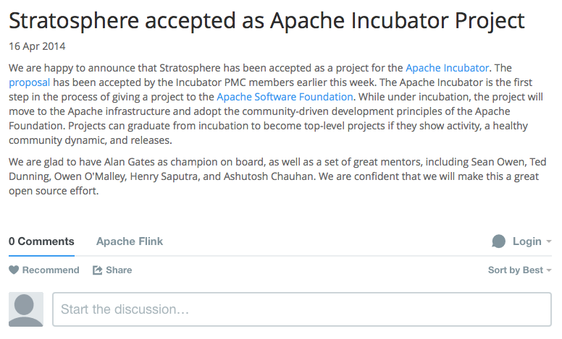
April 16, 2014

Slide 4
Stratosphere 0.2
Pact API (Java)
Pact Optimizer
Pact Runtime & Nephele

Slide 5
Stratosphere 0.4
Pact API (Java)
DataSet API (Scala)
Stratosphere Optimizer
Stratosphere Runtime
Local
Remote
Yarn
Notes:
Iterations, Yarn support, Local execution, accummulators, web frontend, HBase, JDBC, Windows compatibility, mvn central,

Slide 6
Stratosphere 0.5
DataSet API (Java)
DataSet API (Scala)
Stratosphere Optimizer
Stratosphere Runtime
Local
Remote
Yarn
Notes:
New Java API, distributed cache, iteration improvements, collection data sources and sinks, JDBC data sources and sinks, Hadoop I/O format, Avro support

Slide 7
Flink 0.6
DataSet API (Java)
DataSet API (Scala)
Flink Optimizer
Flink Runtime
Local
Remote
Yarn
Notes:
Robustness, netty, move to Apache

Slide 8
Flink 0.7
Hadoop M/R
DataSet (Java/Scala)
DataStream (Java)
Flink Optimizer
Stream Builder
Flink Runtime
Local
Remote
Yarn
Embedded
Notes:
Unification of Java and Scala APIs, logical keys/POJO support, MR compat, collections backend, blob service, mapr filesystem

Slide 9
Flink 0.8
Hadoop M/R
DataSet (Java/Scala)
DataStream (Java/Scala)
Flink Optimizer
Stream Builder
Flink Runtime
Local
Remote
Yarn
Embedded
Notes:
Extended filesystem support, DataStream Scala, streaming windows, mutable/immutable objects, lots of performance and stability, Kryo default serializer, HBase updated

Slide 10
Current master + some outstanding PRs
Gelly
ML
SAMOA
Python
Table
Dataflow
Dataflow
Hadoop M/R
DataSet (Java/Scala)
DataStream (Java/Scala)
Flink Optimizer
Stream Builder
New Flink Runtime
Local
Remote
Yarn
Tez
Embedded
Notes:
Akka rewrite, Tez mode, Python API, Gelly, Flinq, FlinkML. other systems

Slide 11
Summary
Almost complete code rewrite from Stratosphere 0.2 to Flink 0.8
Project diversification
Real-time data streaming
Several frontends (targeting different user profiles and use cases)
Several backends (targeting different production settings)
Integration with open source ecosystem
Notes:
Choice is good for both the users and the poor operations people. If I write a job I don't care if it runs on Flink or Tez

Slide 12
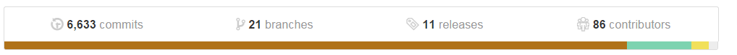
Community Activity
#unique contributors by git commits
(without manual de-dup)

Slide 13
Vision for Flink

Slide 14
What are we building?
A "use-case complete" framework to unify batch & stream processing
Event logs
ETL
Relational
Graph analysis
ML
Streaming aggregations
Flink
Historic data

Slide 15



What are we building?
Via an engine that puts equal emphasis to streaming and batch processing
Real-time data
streams
Flink
(master)
ETL, Graphs, Machine Learning Relational, …
Low latency windowing, aggregations, ...
Event logs
Kafka, RabbitMQ, ...
Historic data
HDFS, JDBC, ...

Slide 16
Batch processing with Flink more well-understood and with clear roadmap
Focus this talk on stream processing with Flink
Gelly
ML
SAMOA
Python
Table
Dataflow
Table
Dataflow
Hadoop M/R
DataSet (Java/Scala)
DataStream (Java/Scala)
Flink Optimizer
Stream Builder
Flink Runtime
Local
Remote
Yarn
Tez
Embedded

Slide 17
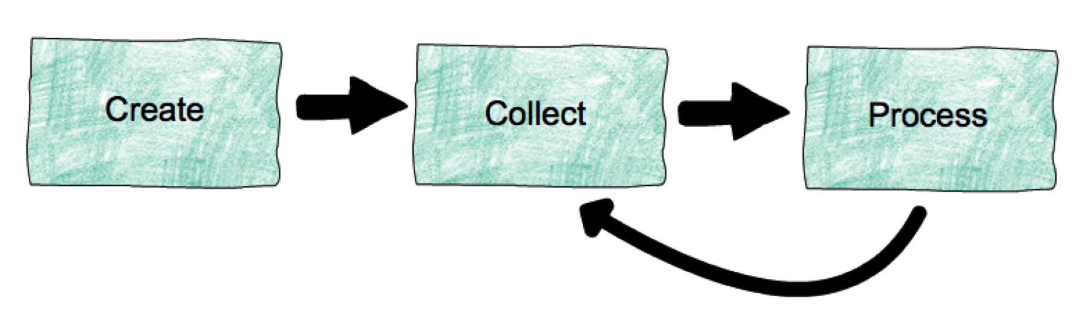
Life of data streams
Create: create streams from event sources (machines, databases, logs, sensors, …)
Collect: collect and make streams available for consumption (e.g., Apache Kafka)
Process: process streams, possibly generating derived streams (e.g., Apache Flink)

Slide 18
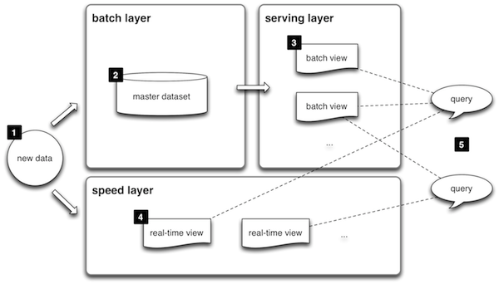
Lambda architecture
"Speed layer" can be a stream processing system
"Picks up" after the batch layer

Slide 19
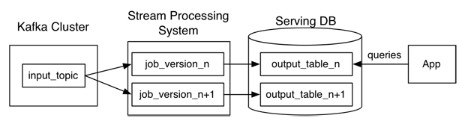
Kappa architecture
Need for batch & speed layer not fundamental, practical with current tech
Idea: use a stream processing system for all data processing
They are all dataflows anyway
http://radar.oreilly.com/2014/07/questioning-the-lambda-architecture.html

Slide 20
Data streaming with Flink
Flink is building a proper stream processing system
that can execute both batch and stream jobs natively
batch-only jobs pass via different optimization code path
Flink is building libraries and DSLs on top of both batch and streaming
e.g., see recent Table API

Slide 21
Additions to Kappa
Dataflow systems are good, but they are the bottom-most layer
In addition to a streaming dataflow system, we need
Different APIs (e.g., window definitions)
Different optimization code paths
Different management of local memory and disk
Our approach: build these on top of a common distributed streaming dataflow system

Slide 22
Building blocks for streaming
Pipelining
Replay
Operator state
State backup
High-level language(s)
Integration with static sources
High availability
See also:
Stonebraker et al. "The 8 requirements of real-time stream processing."
https://highlyscalable.wordpress.com/2013/08/20/in-stream-big-data-processing/

Slide 23
Building blocks for streaming
Pipelining
"Keep the data moving"
Replay
Tolerate machine failures
Operator state
For anything more interesting than filters
State backup/restore
App does not worry about duplicates

Slide 24
Pipelining
Flink has always had pipelining
Pipelined shuffles inspired by databases (e.g., Impala) used for batch
Later, DataStream API used the same mechanism

Slide 25
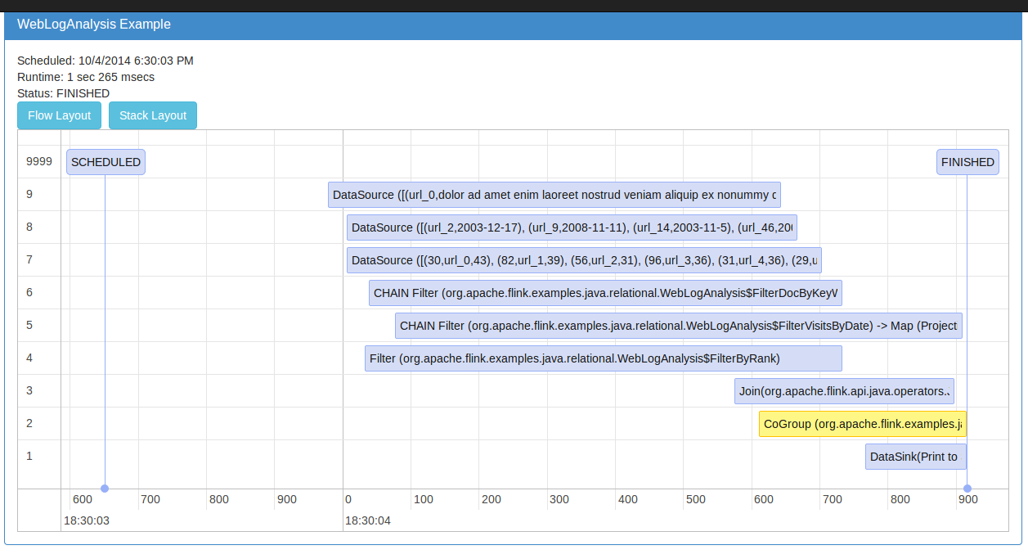
Pipelining

Slide 26
Replay
Storm acknowledges individual events (records)
Flink acknowledges batches of records
Less overhead in failure-free case
Works only with fault tolerant data sources (e.g., Kafka)
Coming: Retaining batches input data in Flink sources for replay

Slide 27
Operator state
Flink operators can keep state
in the form of user-defined arbitrary objects (e.g., HashMap)
in the form of windows (e.g., keep the last 100 elements)
Windows currently need to fit in memory
Work in progress
Move window state out-of-core
Backup window state externally

Slide 28
State backup
Operator checkpoint starting
Pushes checkpoint barriers through the data flow
Checkpoint done
barrier
Data Stream
checkpoint in progress
After barrier =
Not in snapshot
Before barrier =
part of the snapshot
(backup till next snapshot)
Checkpoint done
Chandy-Lamport Algorithm for consistent asynchronous distributed snapshots

Slide 29
Flink Streaming APIs
Current DataStream API has support for flexible windows
Apache SAMOA on Flink for Machine Learning on streams
Google Dataflow (stream functionality upcoming)
Table API (window defs upcoming)

Slide 30
Integrating batch with streaming

Slide 31
Batch + Streaming
Making the switch from batch to streaming easy will be key to boost streaming adoption
Applications will need to combine streaming and static data sources
Flink supports this through a new hybrid runtime architecture

Slide 32
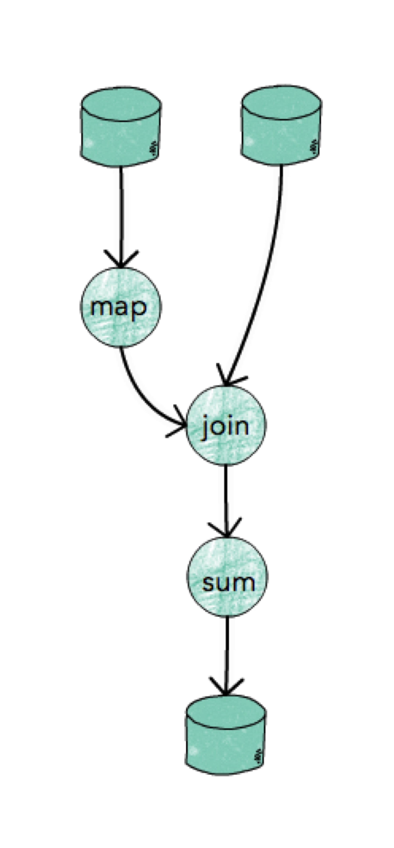
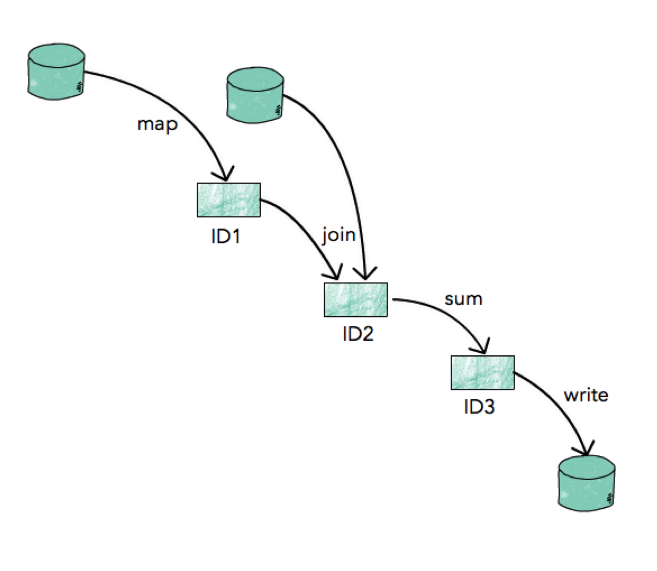
Two ways to think about computation
Operator-centric
Intermediate data-centric
Runtime built
around operators
e.g., Tez, Flink*,
Dryad
Runtime built around
Intermediate Datasets
e.g., Spark
* previous versions of Flink

Slide 33
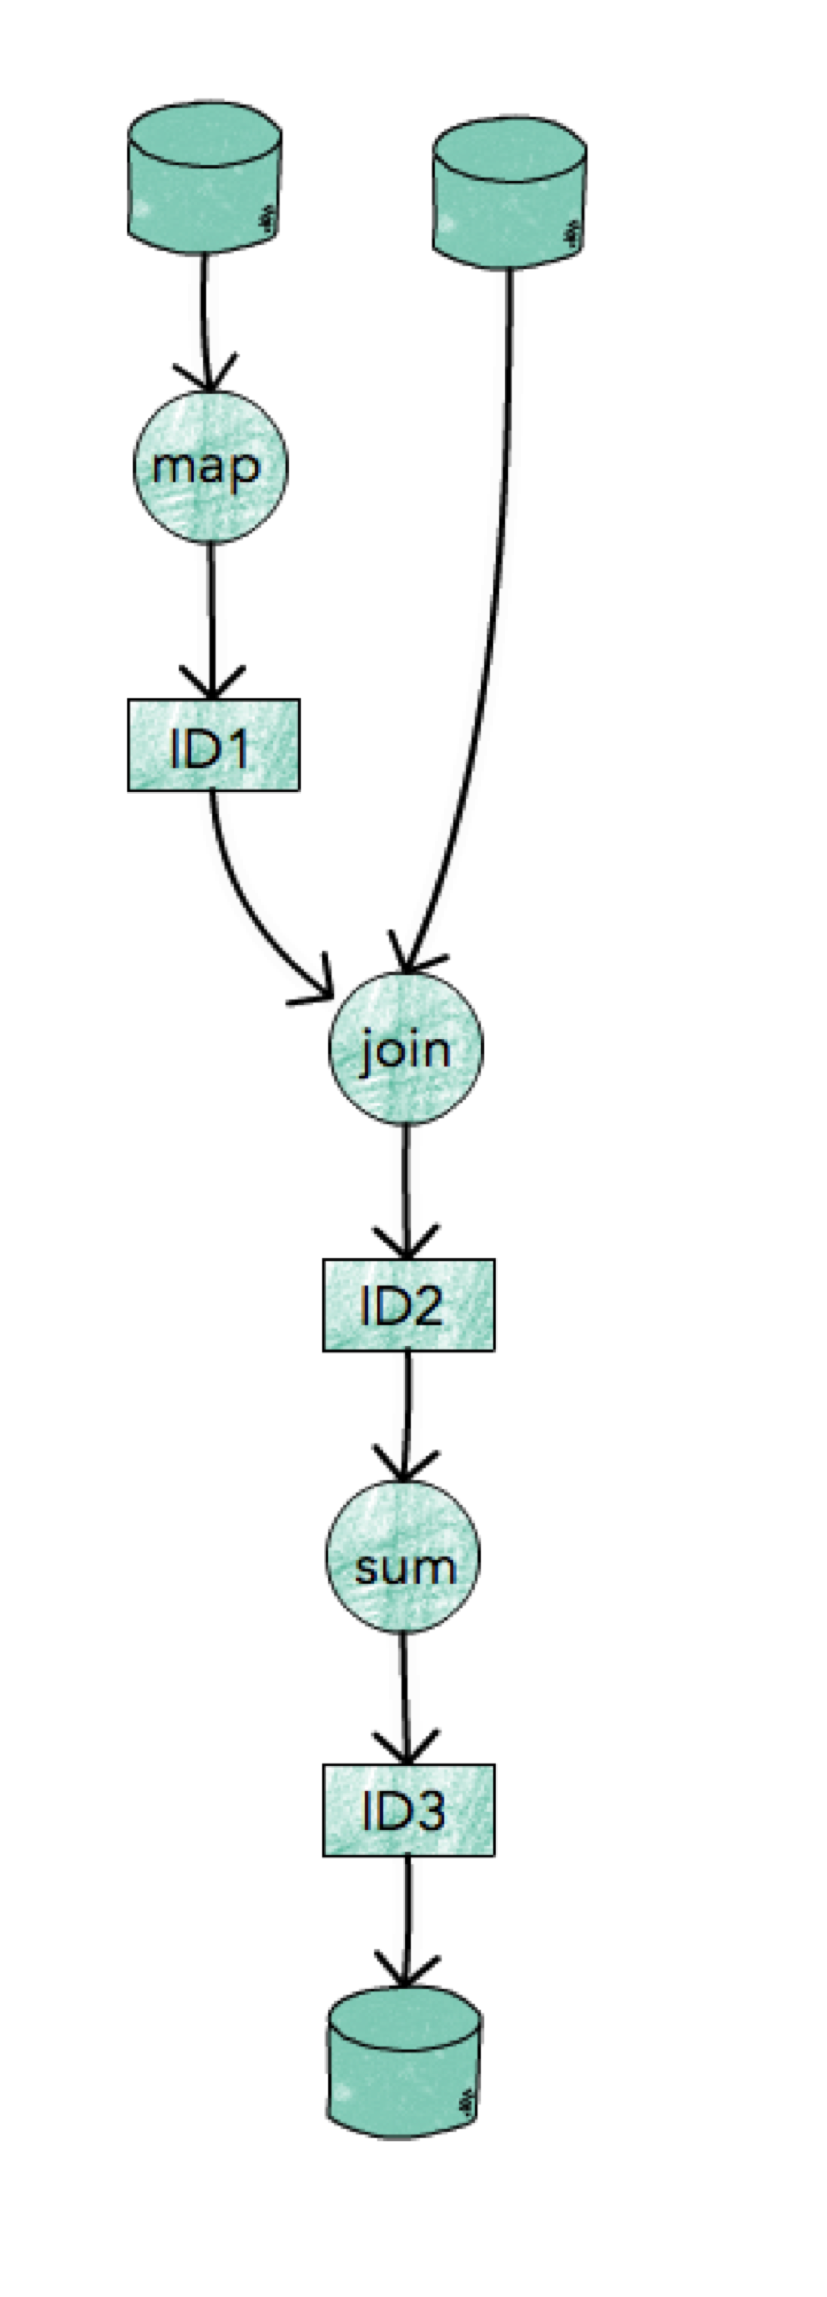
Hybrid runtime architecture
Separating
control (program, scheduling) from
data flow (data exchange)
Operators execute program code, heavy
Operations (sorting / hashing), build state, windows.
Intermediate results
are a handle to the data produced by an operator. Coordinate the "handshake" between data producer and data consumer.
pipelined or batch
ephemeral or checkpointed
with or without back-pressure

Slide 34
flink.apache.org @ApacheFlink

